Slide 1
Video 1: Introduction to Data Warehouses
Agenda:
Define relational database
Consider a series of queries on the UBC Example
Describe the nature of analytical queries
Explore the tension between operational & Analytical Data Needs
Define data warehousing
This section serves to refresh your memory about what a relational database is and how it works. After a quick reminder about how a normalized relational database is structured, we consider the differences between simple (supporting operations) and complex (analytical in nature) queries. This leads us to understanding the need for a different design than the normalized database designs considered in beginning database courses. We introduce and define the concept of data warehousing.

Slide 2

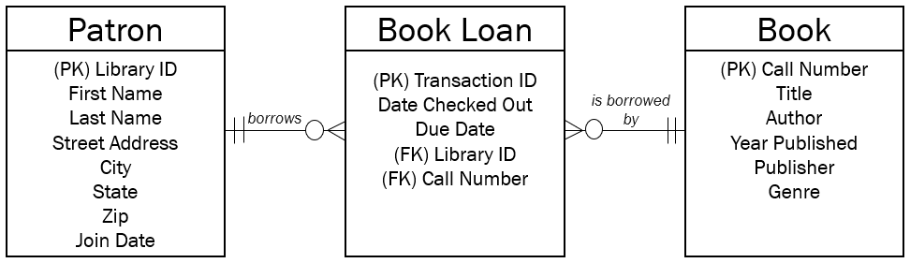
A is a database that stores both between pieces of data.
relational database
data and the relationship
Library
Patron
Book

Slide 3
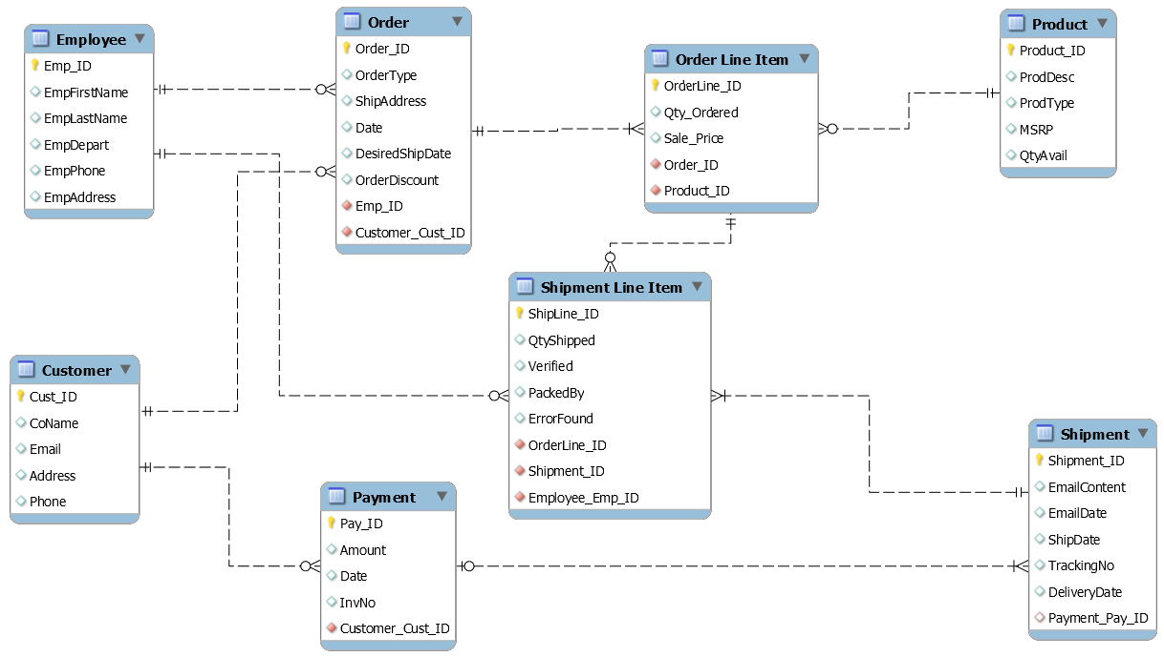
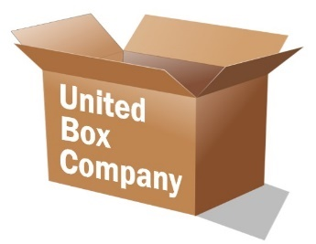
United Box Company (UBC)
Todd Clark
Small Box
Order #44542
100 SB @ $0.75
DigiSonos
100 SB packed by Howard Jones
Digi pays $75 10/1
Order shipped 8/31

Slide 4
Operational Query
Todd wants to send DigiSonos a follow-up sales email. What’s the address?
SELECT Email FROM Customer WHERE CoName=‘DigiSonos’

Slide 5
Operational Query
How many large boxes do we have in stock?
SELECT QtyAvail FROM Product WHERE ProdDesc=‘large box’

Slide 6
Operational Query
Has invoice #542 been paid?
SELECT Pay_ID, Amount FROM Payment WHERE InvNo=‘542’

Slide 7
Analytical Query
I’d like to see a report showing the product discount we’ve been giving to each customer. For each customer, show me the total differences between all the sales prices and all the MSRPs for all of their orders.

Slide 8
Analytical Query
What is the average time between order placement and order shipped for each of our products?

Slide 9
Analytical Query – Example Complexity
What is the average time between order placement and order shipped for each of our products?
SELECT Product_ID, AVG(Order_ID.Date - Shipment.ShipDate)
FROM
Order, Order Line Item, Product, Shipment Line Item, Shipment
WHERE
Order.Order_ID= Order Line Item.Order_ID
AND Order Line Item.Product_ID=Product.Product_ID
AND Order Item List.OrderLine_ID= Shipment Line Item.OrderLine_ID
AND Shipment Line Item. Shipment_ID=Shipment.Shipment_ID
GROUP BY
Product_ID
5 Tables
4 Joins &
1 Group By

Slide 10
Analytical Queries
Often involve numerical aggregations
How many?
What is the average?
What is the total cost?
Often involve understanding dimensions
Sales by state by customer type
Sales by product by store by quarter

Slide 11
Reminder: Normalization is the process of organizing data in a relational database via a set of established rules in order to eliminate or at least drastically minimize redundancy.

Slide 12
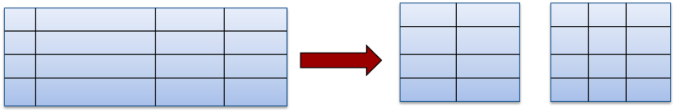
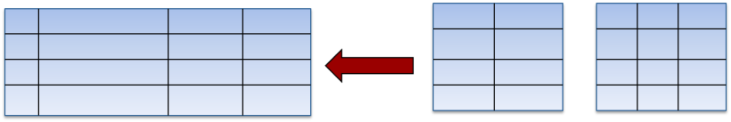
Two Basic Data Needs…
Operational Needs
Normalization
Analytical Needs
Denormalization

Slide 13
Two Basic Data Needs
Operational Needs
Analytical Needs
Day to day focus
Detailed data
Current / Snapshot
Queried rarely
Updated often
Common (write) access
Long time horizons
Aggregate data
Temporal questions
Queried often
Updated rarely (relative)
Limited access

Slide 14
Data Warehouse Definition
A data warehouse is large store of data accumulated from a wide range of sources, stored in a relational database, that is used to guide management decisions

Slide 15
Data Warehousing in a Nutshell
Data Warehouse – Data doesn’t necessarily have to be normalized, but is organized to make common reports efficient. Not real-time.
Periodically Transfer and Transform Data
Normalized Database Solution – Fast, Real-Time, Ideal for Transactions

Slide 16
Data Storage Landscape
Operational Needs
Analytical Needs
Transactional Databases
Data Warehouses
Relational Databases
Data Lakes
Non-Relational Technologies
Alternative Data Stores

Slide 17
Video 2: Design Patterns Used in Data Warehouses
Agenda:
Review of Normalization as a design Principle in Operational databases
Introduction of dimensional Modeling
Star Schema and Snowflake Schema Examples
How should the actual design of a data warehouse differ from operations databases? We focus on the dimensional modeling technique and walk through examples of both a Start Schema and a Snowflake Schema, in order to demonstrate classic design strategies of relational databases used in a data warehouse.

Slide 18
Data Storage Landscape
Operational Needs
Analytical Needs
Transactional Databases
Data Warehouses
Relational Databases
Guiding Principle: Normalization
Notes:
So as we start our conversation about designing databases, let’s begin by reviewing best practices for transactional database design. The guiding principle in this space is Normalization.

Slide 19
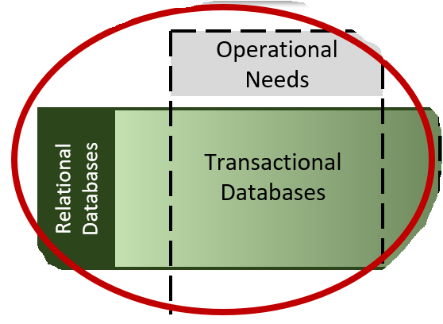
Normalization Review
Normalization is the process of organizing a database with minimal redundancy in order to make it more flexible and remove unnecessary dependencies.
It helps avoid:
Insertion Anomalies
Deletion Anomalies
Modification Anomalies

Slide 20
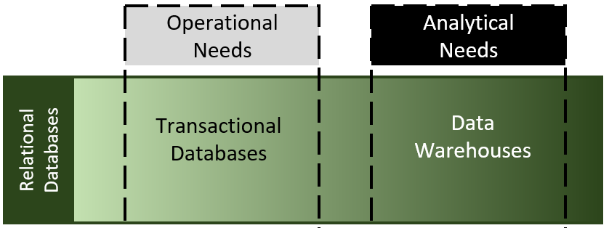
Data warehouses are non-volatile.

Slide 21
What’s the best way to design data warehouses?
Denormalization
Guiding Principle: Dimensional Modeling

Slide 22
Dimensional Modeling
Data design technique that optimizes queries in a data warehouse environment
Instead of thinking about the entities you want to keep up with, think about the key fact that you care about and all of the various dimensions of that fact.

Slide 23

Facts & Dimensions
DIMENSION:
Store it was
sold in
FACT:
A Specific Sale of an Item
DIMENSION:
Time Period of Sale
DIMENSION:
Product details

Slide 24
Facts & Dimensions -> Star Schema
Dimension: Store
Store ID
Name
City
State
District Desc
District Mngr
Region Mngr
Fact: Sale
Store ID
Product ID
Period ID
Dollars
Unit
Price
Dimension: Time
It is an intersection table that expresses the many-to-many relationships among various dimensions
Fact table has many foreign keys
Period ID
Year
Quarter
Month
Day
Current Flag
Sequence
Dimension: Product
Product ID
Description
Brand
Color
Size
Manufacturer

Slide 25
Facts & Dimensions -> Star Schema
Dimension: Store
Store ID
Name
City
State
District Desc
District Mngr
Region Mngr
Fact: Sale
Store ID
Product ID
Period ID
Dollars
Unit
Price
Dimensions contains attributes, but are often denormalized
Could hold calculated/aggregated data
Often 4-15 dimensions per star schema
May connect to two or more fact tables (“conformed”)
Dimension: Time
Period ID
Year
Quarter
Month
Day
Current Flag
Sequence
Dimension: Product
Product ID
Description
Brand
Color
Size
Manufacturer

Slide 26
Snowflake Schema Variation
Dimension: Store
Store ID
Name
City
State
District ID (fk)
When dimension tables are connected to other dimension tables we have a snowflake schema
Useful for info that is not used a lot in queries
Often used to minimize size of dimension table
Fact: Sale
Store ID
Product ID
Period ID
Dollars
Unit
Price
District ID
District Desc
District Mngr
Region ID (fk)
Period ID
Year
Quarter
Month
Day
Current Flag
Sequence
Dimension: Product
Product ID
Description
Brand
Color
Size
Manufacturer
Region ID
Region Mngr

Slide 27
Design Steps for Dimensional Modeling
Consider the subject area and choose the facts
Declare the granularity
Choose dimensions and their attributes

Slide 28
Video 3: Common Data Warehouse Ecosystems
Agenda:
Define relational database
Consider a series of queries on the UBC Example
Describe the nature of analytical queries
Explore the tension between operational & Analytical Data Needs
Define data warehousing
This section serves to refresh your memory about what a relational database is and how it works. After a quick reminder about how a normalized relational database is structured, we consider the differences between simple (supporting operations) and complex (analytical in nature) queries. This leads us to understanding the need for a different design than the normalized database designs considered in beginning database courses. We introduce and define the concept of data warehousing.

Slide 29
Data Storage Landscape
Operational Needs
Analytical Needs
Transactional Databases
Data Warehouses
Relational Databases

Slide 30
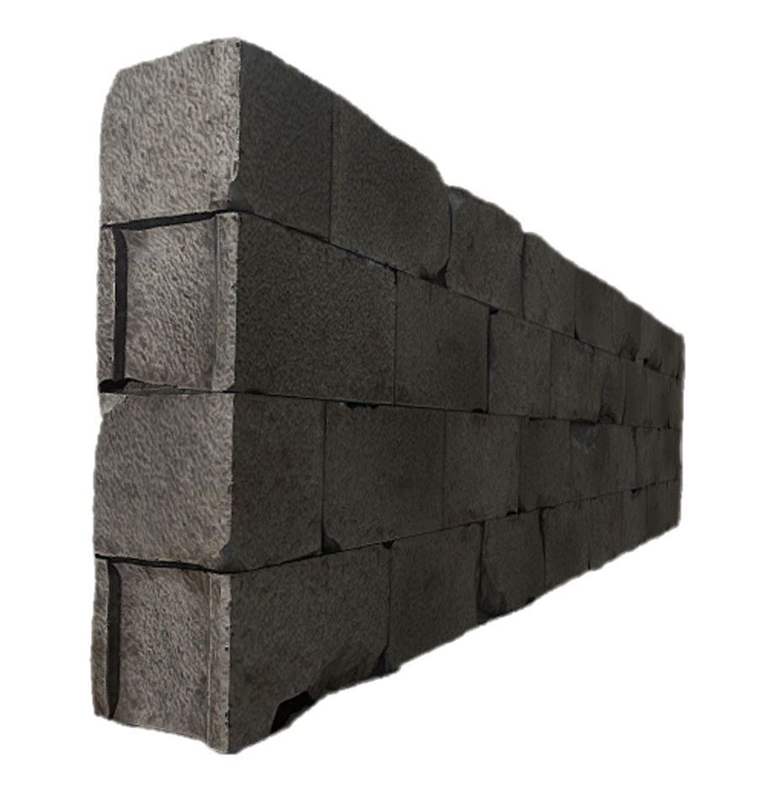
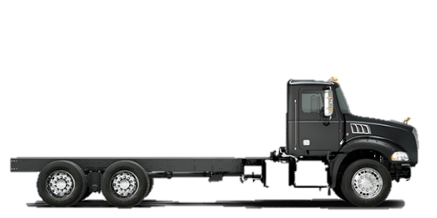
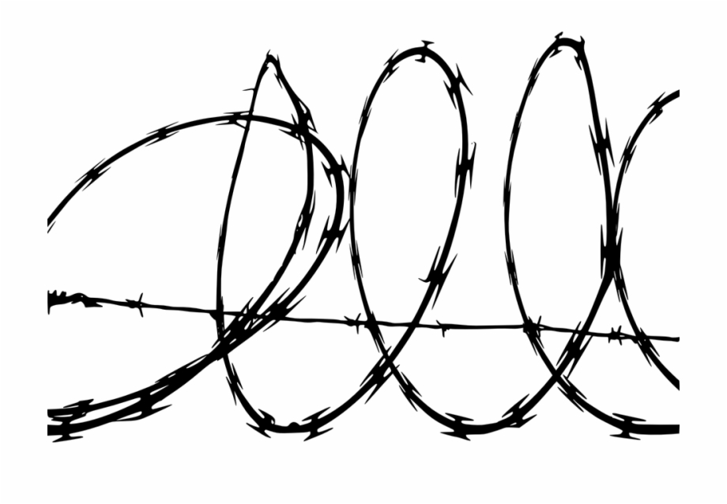
Common Enterprise Growth Pattern
A Story of Functional Transactional Databases
-Sufficiently supporting a function’s operational needs
-Data difficult (or impossible) to share between systems.
Shipping Data
Marketing Data
Production
Data
Regional Sales Data

Slide 31


Analytical Queries
We launched a new product – how can we use marketing research to understand how much production we’ll need?
Ability to detect short-term and long-term sales boosts …by region
…by demographic
…by product
Which supplier delays are costing us the most money and impacting our sales?
Regional Sales Data
Production
Data
Shipping Data
Marketing Data
Data Warehouse
We can’t answer these questions until we can combine data from the multiple operational data sources in the previous slide.

Slide 32
Building a Data Warehouse
Regional Sales Data
“[We need] the ability to combine data virtually or in data warehouses with business intelligence analytics to create flexible insight hubs that can be interrogated according to the business’ need.” – Exec at Coca-Cola
Production
Data
Shipping Data
Marketing Data
This effective use of information is expected to enable the business to make more critical time-sensitive decisions, as well as look back in history more accurately for trending and strategic optimization analysis.
Data Warehouse

Slide 33
Data Warehousing in a Nutshell
Data Warehouse – Data doesn’t necessarily have to be normalized, but is organized to make common reports efficient. Not real-time.
Periodically Transfer and Transform Data
Normalized Database Solution – Fast, Real-Time, Ideal for Transactions

Slide 34
Data Warehousing in a Nutshell
Data Warehouse – Data doesn’t necessarily have to be normalized, but is organized to make common reports efficient. Not real-time.
Periodically Transfer and Transform Data
Periodically Transfer and Transform Data
Periodically Transfer and Transform Data
Periodically Transfer and Transform Data
Transaction Database
Transaction Database
Transaction Database
Transaction Database

Slide 35
Data Warehouse Description
A database solution that is…
Integrated & Enterprise-Wide (uses data from across the organization)
Time Variant (ability to store historical data, such as prior prices of your product offerings)
Non-Volatile (write access is heavily controlled – this should be a “single [historically accurate] truth” and not for various parties to edit)

Slide 36

Common Data Warehouse Ecosystem
Data Sources
ETL Staging*
Data
Warehouse
Users
Orders
Staging
Holistic
Meta
Raw
Customers
Reporting
Summary
Inventory
Mining
*On-going process, though hopefully designed well & stable.

Slide 37
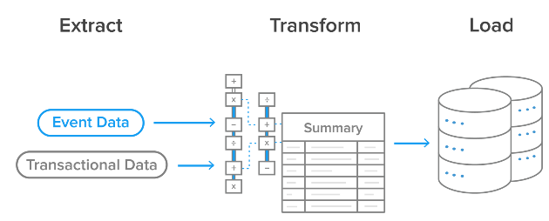
Common Data Warehouse Ecosystem
Data Sources
ETL Staging*
Data
Warehouse
ETL Process?
Orders
Staging
Holistic
Meta
Raw
During a Data Warehouse Project, ETL involves...
80% of time & resources
50% of unexpected costs
Transform Phase
-Clean and aggregate (as necessary) the data
-Cleaning includes translations to common data formats across sources
Extract Phase
-Identify all desired data
-Plan a way to routinely export the data that doesn’t have a negative impact on the source system response times
Load Phase
-Importing or adding the data to the data warehouse
-Plan a solution that doesn’t have a negative impact on the data warehouse response time
Customers
Summary
Inventory
*On-going process, though hopefully designed well & stable.

Slide 38
Common Data Warehouse Ecosystem
Data Sources
ETL Staging*
Data
Warehouse
Users
Orders
Staging
Holistic
Meta
Raw
Customers
Reporting
Summary
Inventory
Mining
*On-going process, though hopefully designed well & stable.

Slide 39
Data Marts
Everything is relative…
Data Warehouse
Data Mart
Holds multiple subject areas
Holds very detailed information
Works to integrate all data sources
Sub-set of a data warehouse solution
May hold summarized data
May be designed for a specific analytical function
May be designed for a specific geography

Slide 40
Common Data Warehouse Ecosystem
Data Sources
ETL Staging
Data
Warehouse
Data Marts
Users
Purchasing
Orders
Staging
Holistic
Meta
Raw
Customers
Marketing
Reporting
Summary
Inventory
Accounting
Mining

Slide 41
Video 4: Considerations when Choosing a Data Warehouse Vendor
Agenda:
Major factors for choosing a data warehouse vendor
Cloud Solutions as part of the data warehouse decision
In this video we talk through some of the major points to consider when considering a RDBMS vendor partner for a data warehouse solution. We also clarify what “cloud solutions” are when deciding on data warehouse architecture.

Slide 42
Data Storage Landscape
Operational Needs
Analytical Needs
Transactional Databases
Data Warehouses
Relational Databases

Slide 43
Common Data Warehouse Ecosystem
Data Sources
ETL Staging
Data
Warehouse
Data Marts
Users
Purchasing
Orders
Staging
Holistic
Meta
Raw
Customers
Marketing
Reporting
Summary
Inventory
Accounting
Mining

Slide 44





Data Warehouse Vendors?
Data
Warehouse
Data Marts
Purchasing
Holistic
Meta
Raw
Marketing
Summary
Accounting

Slide 45
Choosing a RDBMS for a Data Warehouse
Size, speed, and scale
Pricing
Established vendor relationships
Built-in analytics tools
Hosted or not

Slide 46
“Cloud” in the Data Warehouse Decision
License the software to run on your server.
Do we want to be in charge of the server hardware?
Yes
“Traditional” Hosted Services – Your assigned hardware & infrastructure, managed by the vendor.
No
Dedicated
Hosted: Do you want dedicated hardware or capitalize on shared-hosting?
Share
Cloud Services – Form of Hosted; Vendor distributes customer needs and optimizes hardware use.
Notes:
https://www.star2star.com/insights/blog/cloud-vs-hosted-services

